Slide 1
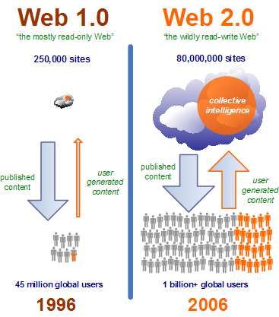
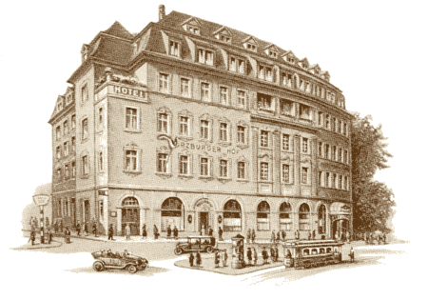
Marketing in hospitality

Slide 2
Marketing
„Customer is king“ or holistic approach with internal and external marketing?
Selling your product or produce what you can sell?
How big is your market?
Potential market, potential sales, potential volume

Slide 3
Marketing – Specifics of service marketing
 | Consumer goods Marketing | Industrial goods Marketing | Service Marketing
Offer | Mass products, often low price, standardized | Often customized, individual product high price | Immaterial, different levels of customization and price
POS | Retail, indirect | Producer, direct | Wholesale and retail
Purchase decision process | Short, often emotional | Short to very long, mostly rational | Short to long, oftern more emotional
Marketing Advertisement/PR Price policy Product policy Direct Sales After Sales Service | Mass marketing ++ ++ + -- - | Individual marketing + 0 + ++ ++ | Image marketing ++ + + ++ ++

Slide 4
Marketing challenges
Demand situation | Marketing challenge | Form of Marketing
Negative Demand | Turn around Demand | Conversion Marketing
Lack of Demand | Create Demand | Stimulation Marketing
Latent Demand | Develop Demand | Development Marketing
Stagnating Demand | Vitalize Demand | Revitalisation Marketing
Fluctuating Demand | Synchronize Demand | Synchro Marketing
Optimal Demand | Keep level of Demand | Sustainment Marketing
Overboarding Demand | Reduce Demand | Reduction Marketing
Harmful Demand | Eliminate Demand | Contra Marketing

Slide 5
Customer Retention as Marketing task
Before, during and after stay:
  Birthday greetings
  Newsletter
  Special customized offers
  Free local calls
  Visit to kitchen
  Adressing by name by all service staff
  Thank you letter after departure
  Teddy for the children
  Etc.

Slide 6
Market segmentation
Potential Guests
  Interest, spending power, access
Demand measurement by
  Competitors, own company, Research institutes
Prediction of own company Demand
  Predicted turnover: Q = n ∙ q ∙ p
    Q = accessible potential of market
    n = number of guests
    q = average sales per guest
    p = average price per unit
Classical Segmentation
  Geographical, demographical and psychographical
Postmodern Segmentierung
  Lifestyle, activities, milieus

Slide 7
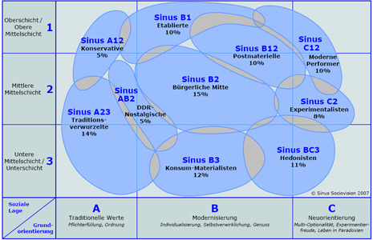
Market segmentation
http://www.sinus-sociovision.de/

Slide 8
Market research
Primary research
  Own research (company or Institute)
    Surveys
    Observation
    Experiment
    Reporting
Secundary research
  Internal Sources
  External Sources

Slide 9
Trends in customer behaviour in hospitality
1. Changing customer profile
2. Shifting consumption pattern
3. Intensifying competition / continuing consolidation
4. Growing segmentation
5. Escalating concern for safety / security
6. Increasing value orientation
7. Increasing influence of the internet

Slide 10
Marketing instruments & Marketing mix
Product policy
Price policy
Distribution policy
Communication policy
Marketingmix
  Product mix
  Communication mix

Slide 11
Internal and external Marketing
External Marketing
  Adressed towards:
    Guests
    Public/Media
    Supplier
    Financial institutions
    Authorities
Internal Marketing
  Goal: Acquisition and Retention of motivated employees who understand and represent the company credo

Slide 12
Marketing planning
Elements of the marketing plan
  Analysis of current market situation
  Research and selection of target markets
  Planning of Marketing strategies
  Planning of Marketing programs
  Implementation and managing of Marketing programs
Sliding goals
  Short, Medium, Long term
Permanent Marketing information feedback
  Analysis of Demand
  Analysis of Competitors
  Analysis of Products
  Customer feedback
  Prognosis of Market development

Slide 13
Marketing for Hospitality companies
Discussion
Major problems:
Branding – Decreasing differentiation, decreasing customer loyalty
Necessitiy of cooperation – Accomodation and gastronomy as elements of a destination
…

Slide 14
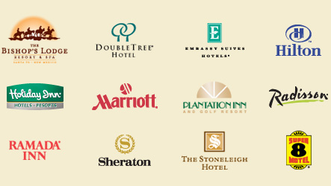
Brand loyalty and customer retention

Slide 15
Brand loyalty
Saturated markets
Exchangeable services
Expansion of hotel groups
Branded hotel groups („Markenhotellerie“)
according to DeHoGa in Germany:
  4 Hotels or more
  1 or more Hotel in Germany
  Own umbrella brand used in Germany

Slide 16
Brand loyalty
Brands have important functions for the customer:
  Identification
  Orientation
  Trust
  Quality indication
  Prestige

Slide 17
Customer loyalty
Advantages for hotel
  More profit because of
  Higher frequency
  Higher bills
  Decreasing costs for marketing
  Additional business by WOM communication
Advantages for customers
  Less cognitive dissonances
  Learning effects of the hotel
  Reduction of risk
  Increased status
  „added value“
  Emotional wellbeing

Slide 18
Customer retention
Causes
By contract By price/economic reasons By technical reasons By situational reasons | By emotional reasons
Instruments: Product: Customer as employee Price: Customer cards, customers clubs, price guarantees Promotion: After-Sales communication Place: Internet offers, free parking

Slide 19
Customer loyalty
Discussion:
How efficient are customer card / club systems for different target groups?

Slide 20
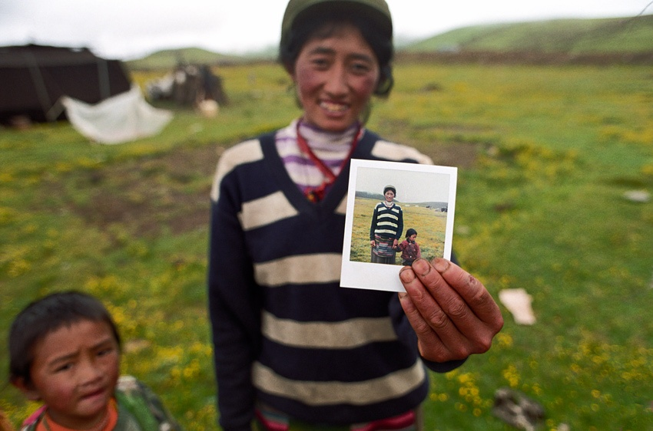

Slide 21
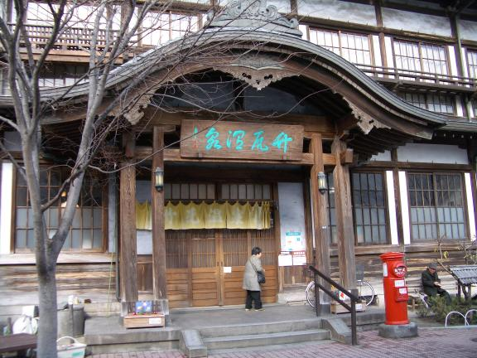
Wellness and hospitality

Slide 22
Wellness in Hotels
Importance:
  Worldwide major trend for additional services in hotels
  Spas especially in original destinations of treatments (Aryuveda – India, TCM - China etc.)
  More than 700 hotels in Germany , more than 3 billion Euro additional turnover in Germany (2005)
Problem:
  Wellness more than „pampering“
  Demand developing towards Medical wellness
  Hotels can only provide short-term wellbeing
  „Mogelpackung“
  Wellness dept. mostly not profitable by itself

Slide 23
Wellness in different types of hotels
Wellness hotels / spas
  Broad range of in-house wellness offers
  Wellness as cornerstone of Marketing -philosophy
  Quantitative aund qualitative high-level offers
  Major components: Aqua area, Fitness center, Beauty, Yoga/Taiji etc.
  Architecture and gastronomy integrated into wellness concept
  Mostly 4 Star hotel
Holiday hotels
  Wellness not central part of product, used to attract off-season customers
  Majority of Wellness offers in leisure and sport
Business and congress hotels
  Wellness not central part of product, used as additional sales argument
  Large differences in quality
  Majority of Wellness offers: Sauna, Swimming pool, Fitness

Slide 24
Occupancy rates of rooms in hotels with Wellness offers

Slide 25
Age structure of guests in German wellness hotels

Slide 26
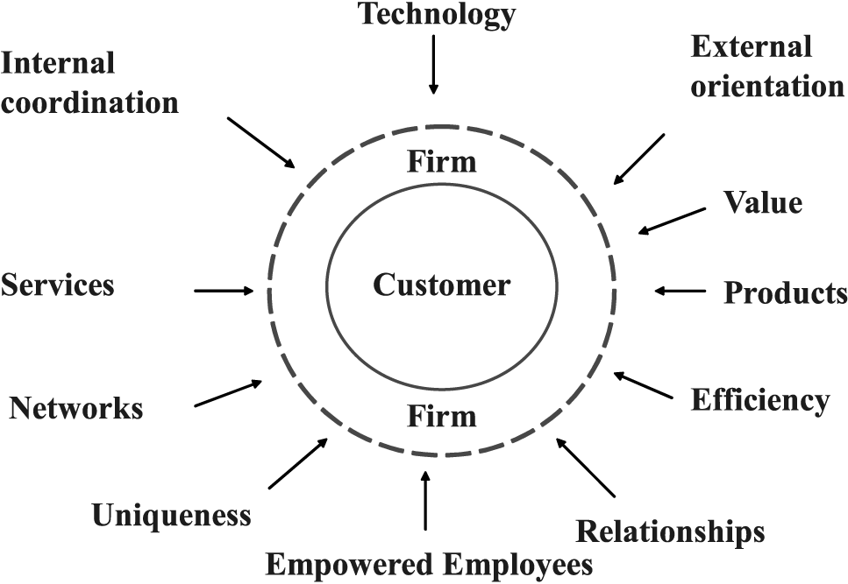
Starting a new business in the hospitality sector

Slide 27
Becoming an Entrepreneur
Which advantages / disadvantages do you see?
Which characteristics should a successful entrepreneur have / develop?
Why start the entrepreneural career in the hospitality sector?

