Slide 1
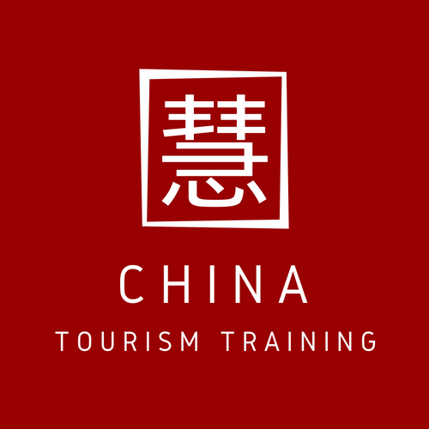
CTT China Tourism Training
COTRI China Outbound Tourism Research Institute
The Hong Kong Polytechnic University, School of Hotel and Tourism Management

Slide 2
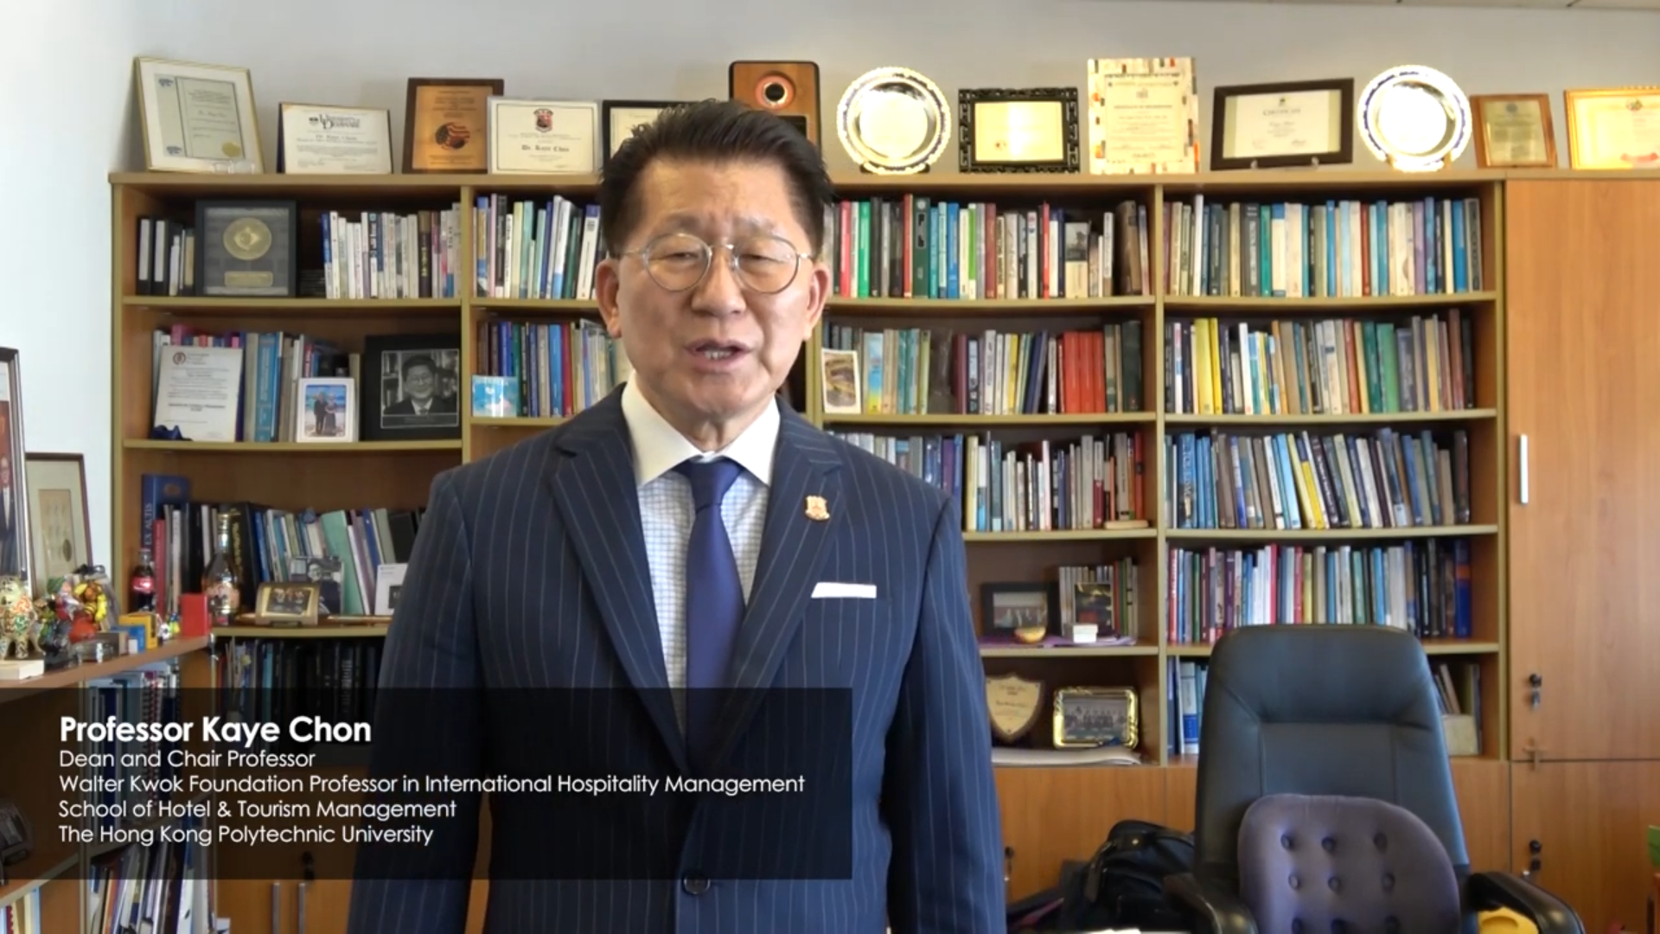
Prof. Dean Kaye Chon’s invitation to join
CTT China Tourism Training
https://www.youtube.com/watch?v=BiqUdPKPeaU
Congratulations on your partnership with Hong Kong Polytechnic University. I am familiar with their online training courses and I'm sure that this will be a great success.
There is certainly a real need here in the Middle East region to upskill teams to understand how to capitalize fully on the opportunities that the Chinese market offers.
Caragh Curran, Managing Director
Sustainable Tourism Consultants (Dubai)
It has been a pleasure to learn that COTRI has developed the online training programme “CTT China Tourism Training” together with the Hong Kong Polytechnic University School of Hotel and Tourism Management.
Both organisations are active members of PATA and recognised as outstanding in their respective fields. PATA will recommend to all PATA members and PATA chapter members the CTT programme.
Dr. Mario Hardy, CEO
PATA Pacific Asia Travel Association

Slide 3
CTT China Tourism Training
COTRI CHINA OUTBOUND TOURISM RESEARCH INSTITUTE &
THE HONG KONG POLYTECHNIC UNIVERSITY - SCHOOL OF HOTEL AND TOURISM MANAGEMENT
THE GLOBAL STANDARD ONLINE TRAINING FOR THE CHINESE OUTBOUND TOURISM MARKET
COTRI China Outbound Tourism Research Institute, the leading research institute for Chinese outbound tourism, and the globally top-ranked The Hong Kong Polytechnic University, School of Hotel and Tourism Management (SHTM), have brought their expertise together to provide the comprehensive CTT China Tourism Training online training programme, aimed at tourism professionals worldwide working with the Chinese outbound tourism market.
Both market leaders have rich experience in the field: COTRI has delivered its intensive face-to-face CTW Chinese Tourist Welcome training programme to over 2,000 participants globally, while SHTM’s MOOC on China Tourism and MicroMasters Program for International Hospitality Management attracted over 50,000 participants worldwide online.
Notes:
Check the front and layout

Slide 4
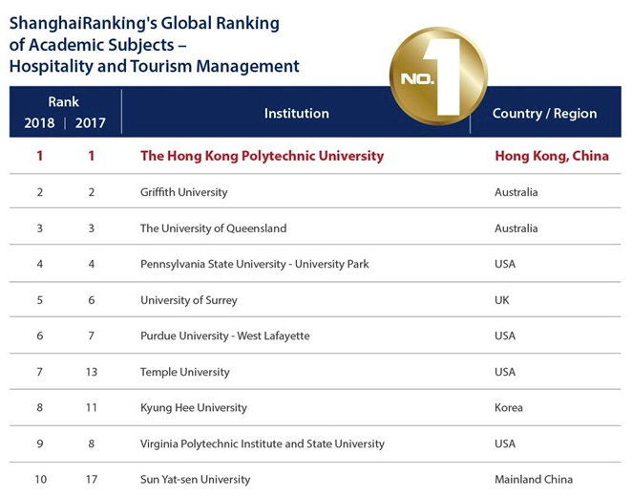
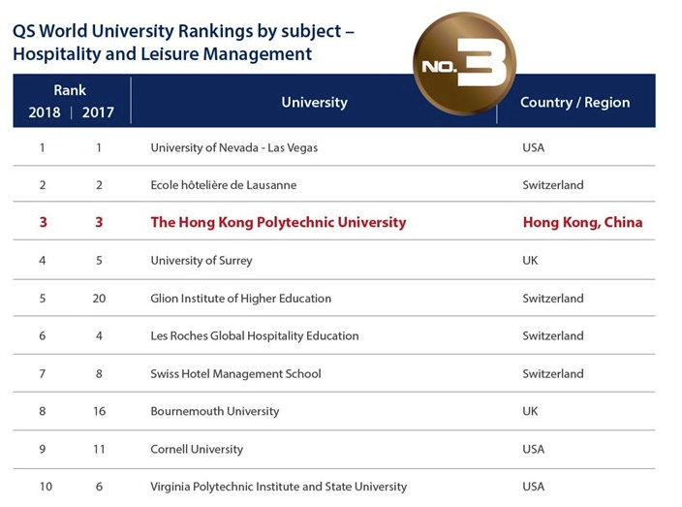
CTT China Tourism Training
COTRI CHINA OUTBOUND TOURISM RESEARCH INSTITUTE &
THE HONG KONG POLYTECHNIC UNIVERSITY - SCHOOL OF HOTEL AND TOURISM MANAGEMENT
GLOBAL RANKINGS:
Notes:
Check the front and layout

Slide 5
CTT China Tourism Training
CTT PROGRAMMES FOR THE FIVE MAJOR AREAS OF INTERNATIONAL TOURISM
CTT builds upon decades of expertise provided by COTRI’s and SHTM’s global education and training resources to offer a premium learning experience drawing on academic reputation and industry knowledge of both partners.
FIVE BRANCH-SPECIFIC CTT CHINA TOURISM TRAINING PROGRAMMES
The CTT China Tourism Training programme offers five specialised training tracks, tailor made for the specific needs and challenges of the service chain of international travel and tourism service providers.
CTT Hospitality
CTT Destinations
CTT Retail
CTT Attractions
CTT Transportation
Notes:
Check the front and layout

Slide 6
CTT China Tourism Training
TARGET AUDIENCE PER BRANCH-SPECIFIC TRACK
Hospitality For all hospitality service providers including hotels, resorts, hostels, serviced apartments, B&B and other types of accommodation, casinos, restaurants and other providers of food and drinks
Destinations For all Destination Management and Destination Marketing Organisations on local, regional, national, international and topical level, Tourism Boards, Inbound Tour Operators and Ground Handlers
Retail For all kind of retailers, including shops, boutiques, shopping malls, outlet cities, duty-free shops, shops in hotels, attractions, airports etc. and other retail outlets
Attractions For all kinds of tourist attractions including museums, galleries, monuments, landmarks, zoological and botanical gardens, theme parks, amusement parks, castles, towers, churches, temples, bridges, national parks, beaches and other natural or man-made attractions
Transportation For all kind of transportation service providers including airlines, airports, rail companies, railway stations, coach companies, ferries, cruise companies, car, bike or boat rental companies and public transport providers

Slide 7
CTT China Tourism Training
STRUCTURE AND LEARNING BASED OUTCOMES
Each CTT track covers 12 hours of content and consists of eight chapters of 90 minutes each.
Each chapter has three sub-chapters of 3 x 30 minutes. The table below outlines the structure and main content of each chapter.
The whole training can be accessed any time and on different devices.
30 min: Basic information about chapter content
30 min: Best practice examples from industry
30 min: In-depth discussion, application examples, further reading
Watch the CTT introduction video:
https://china-outbound.com/china-tourism-training/
Chapter 1 | Chapter 2 | Chapter 3 | Chapter 4 | Chapter 5 | Chapter 6 | Chapter 7 | Chapter 8
Introduction – Basics of Chinese outbound Tourism | Cultural Background – Cultural background of Chinese outbound tourists | Feeling Welcome – How to make Chinese feel welcome, how to deal with critical incidents | Market Segments – Chinese market segments specific demands | Product Adaptation – Product adaptation for Chinese FITs, customised and package tour travellers | Communication Channels – Communication strategies, online and offline marketing, social media and fairs | Distribution Channels – Online and offline distribution and sales channels | Summary – Chinese Customer Journey, next steps
Notes:
Check the front and layout

Slide 8
CTT China Tourism Training
KEY FEATURES OF THE TRAINING
The CTT China Tourism Training programme addresses all major questions and topics relevant for specific industry sectors covered.
Discussion in live-chats empower participants to address questions, to exchange know-how and ideas and to stay connected 24/7 with all other participants and with technical support. The digital learning space enables participants from different professions and backgrounds to exchange insights and ideas among their peers.
Best Practice Examples are a cornerstone of CTT. Drawn from a wide range of high-level industry sources, they offer videos, interviews, websites and other materials provided by leading global tourism service providers and Chinese industry experts. They intensify the learning experience and support participants to develop a successful and sustainable Chinese outbound business.
Language: English
Flexible, self-paced, and interactive online learning
Individual enrolment and commencement of the training
24/7 discussion forum for networking and communication among participants
Technical assistance
Individual solutions, additional online and offline elements for corporate customers or groups
Membership of both the CTT Alumni Network and the SHTM Alumni Network for all successful participants
PRACTICALLY FOCUSED, INTERACTIVE & ENGAGING

Slide 9
CTT China Tourism Training
CORPORATE TRAINING SOLUTIONS AND INDIVIDUALISATION
Individual corporate packages can include:
Face-to-face workshops for kick-off or conclusion of a training
Integration with on-site strategy development provided by COTRI or SHTM
Co-branding and marketing opportunities
Problem-centric workshops or group sessions, mentored by experienced trainers
Periodically online follow-ups and consulting sessions
Membership of the CTT Alumni network for companies and organisations
CTT CORPORATE OPTIONS:
Additional features of customisation plus competitive pricing
For companies and organisations, the CTT programme provides the opportunity for customisation and tailor-made training needs for every business environment.
Interactive supervised problem-centric group activities, synchronised discussion groups, offline kick-off or concluding workshops with adjustments to corporate identity can be arranged.

Slide 10
CTT China Tourism Training
CTT ALUMNI NETWORK (CTTAN) MEMBERSHIP FOR LIFE
BRINGING TOGETHER ALL TOURISM SERVICE PROVIDERS FOR THE CHINESE MARKET
The CTT Alumni Network offers:
Annual CTTAN global conference and regular alumni workshops, held in alternating destinations around the world
Free membership in SHTM Alumni Association
LinkedIn groups for networking among alumni with regular updates and special input from COTRI experts
Job platform allowing companies looking for qualified employees to find YOU – a knowledgeable China outbound expert in hospitality
The CTT Alumni Network (CTTAN) is the unique platform for all successful participants of the CTT programme, creating a high-profile network of experts for the Chinese outbound tourism with members from across the world.
CTTAN members benefit from networking, exclusive information exchange, events and gain access to the exclusive career platform for China-outbound tourism professionals.
Membership is free for life.

Slide 11
CTT China Tourism Training
SHTM ALUMNI ASSOCIATION (SHTMAA)
ADDITIONAL FREE MEMBERSHIP IN ONE OF THE OLDEST ALUMNI ASSOCIATIONS IN ASIA
The SHTM Alumni Association offers:
Free membership for CTTAN members in one of the oldest and most prestigious Alumni associations
Participation in regular alumni activities
SHTMAA newsletter
Free annual submission fee to the SHTM Dining Society
Free entry and use of SHTM Chi Woo Lui Hotel and Tourism Resource Centre in Hong Kong
The SHTM Alumni Association (SHTMAA) was founded in 1993. It‘s mission is to achieve service excellence through the joint efforts.
All successful participants of the CTT Alumni Network can also become members of SHTMAA. The membership entry fee is waived for CTTAN members.
Members will be able to attend all alumni activities and receive the professional SHTMAA newsletter. Members also enjoy further benefits.

Slide 12
CTT China Tourism Training
WHY JOIN CTT today?
BENEFITS
UNIQUE INSIGHTS | 1. | Information from leading research and training organisations and state-of-the-art Best Practice Examples enable participants to gain unique insights from leading global tourism providers and Chinese industry experts and help to successfully apply them to practical approaches for working with Chinese customers
UP-TO-DATE INFORMATION | 2. | Up-to-date orientation into preferences and demands of Chinese travellers. Gaining an edge on the competition by understanding the Chinese traveller and how to adapt services and products to the specific needs of different segments of the Chinese source market
STRATEGIES & GUIDANCE | 3. | Strategies and guidance to improve performance and success in China’s outbound travel market
CERTIFICATE BY COTRI AND SHTM | 4. | Successful participants receive a verified academic certificate from two of the leading institutions in the field - SHTM and COTRI
ALUMNI NETWORKING | 5. | Membership of the CTT Alumni Network and SHTM Alumni Association

Slide 13
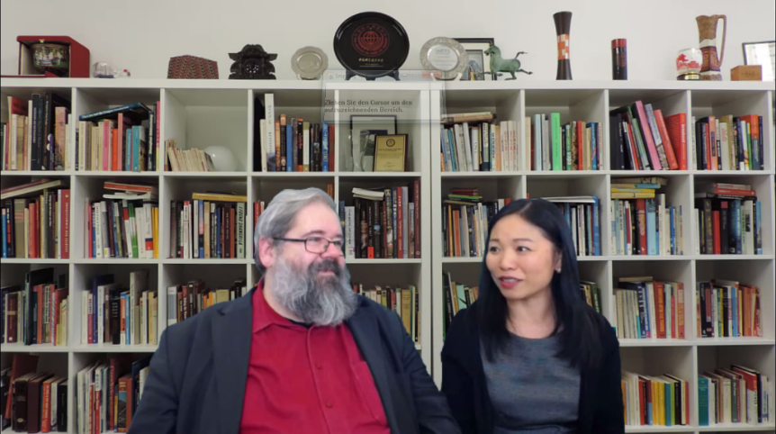
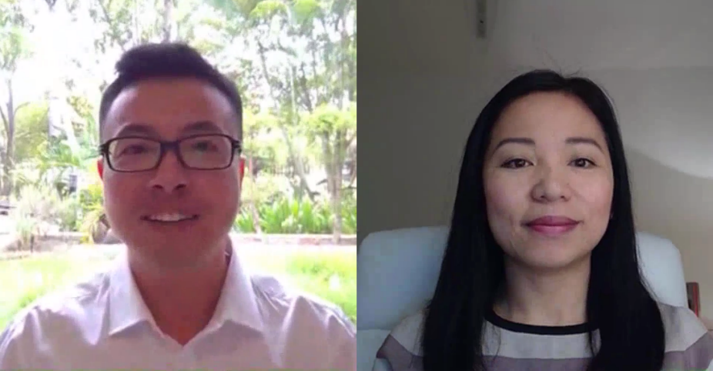
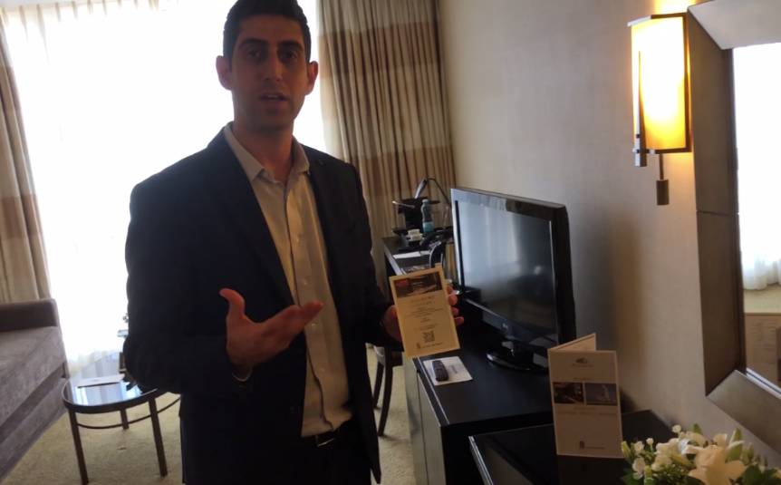
CTT China Tourism Training – CTT Programme – Screenshots of Content
Experts Discussion
Interviews with Practitioners
Best Practice Examples
Lecture with Slides
www.china-outbound.com/ctt

Slide 14
COTRI China Tourism Training
ABOUT SHTM & COTRI
School of Hotel and Tourism Management, The Hong Kong Polytechnic University
For close to 40 years, The Hong Kong Polytechnic University’s School of Hotel and Tourism Management (SHTM) has refined a distinctive vision of hospitality and tourism education and become a world-leading hotel and tourism school, exemplifying its motto of Leading Hospitality and Tourism.
As Hong Kong’s Hospitality School, the SHTM is ranked amongst the top worldwide. Close to 2,000 students are enrolled in the School guided by an international team of 75 academics drawn from 22 countries and regions, the majority of whom possess hospitality or tourism industry managerial experience – an important quality in an educational programme that provides practical and specialised business education.
The School is advancing teaching, learning, and research, inspiring a new generation of passionate, pioneering professionals to take their positions as leaders in the hospitality and tourism industry.
COTRI China Outbound Tourism Research Institute COTRI is the world’s leading independent research institute for consulting, research, information, training, and quality assessment relating to the Chinese outbound tourism market. COTRI is an affiliate member of UNWTO, WTTC Knowledge partner, a member of PATA, ETOA, and WTA.
COTRI’s main goal is to enable private companies and public institutions all over the world to offer successfully high quality travel, tourism, and leisure services for Chinese visitors according to their specific expectations and demands.
To reach this goal, COTRI offers a broad range of customised services including consulting, market research, strategy development for market entry and market penetration, qualitative and quantitative analysis and data, training, certification, and counselling for destinations, public organisations and companies.

