Slide 1
ITM MA III Dec 13, 2009
Marketing: "Old" Media and the problem of global marketing campaigns.
Internet 2.0 - Social Media Marketing across cultures - possible because user-driven?

Slide 2
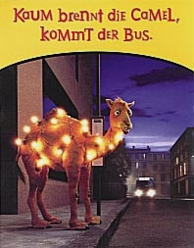
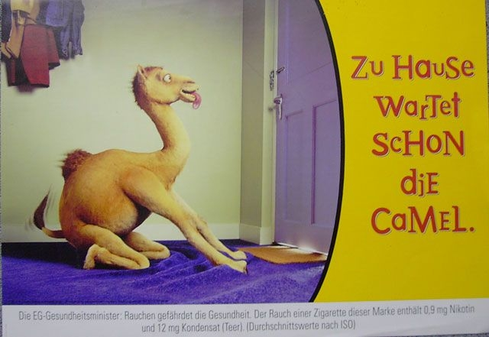
Marketing: "Old" Media and the problem of global marketing campaigns.

Slide 3
Internet 2.0 - Social Media Marketing across cultures - possible because user-driven?
„Currently more than 700 million people worldwide are using online networks for communication and networking.“
(Back, Universität Mainz, Nov. 2009)
“The Future Consumer is aware, confused, information-bloated, demanding, fickle, smart, empowered, connected, in control, curious, resourceful, wellresearched, savvy, impatient, discriminating, mobile, discerning, capricious, dogmatic ...“
(Yeoh Siew Hoon, ITB Berlin, March 2009)

Slide 4
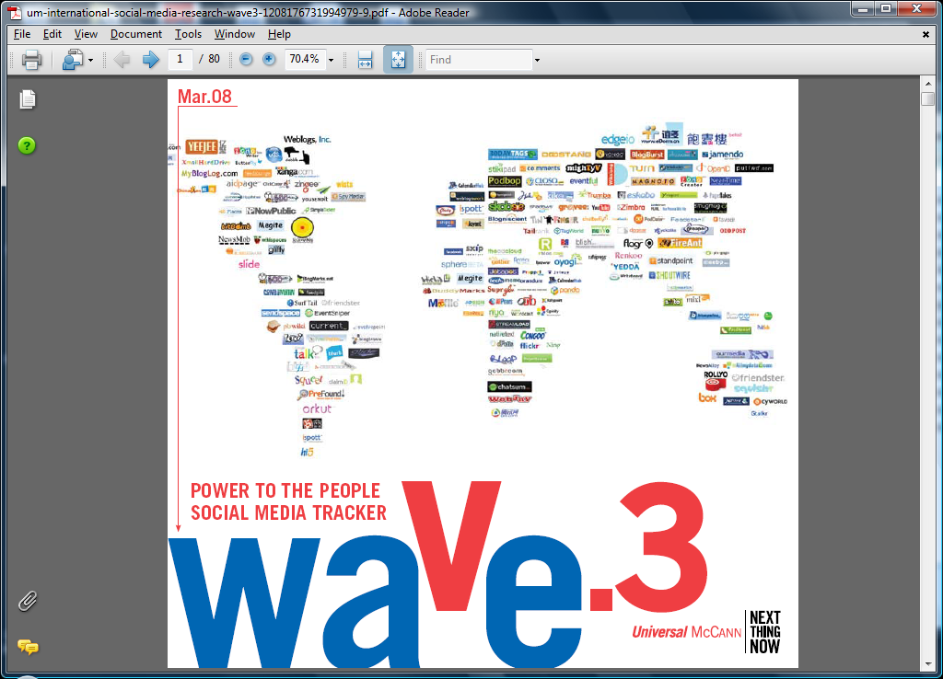
The World goes Social Media…

Slide 5
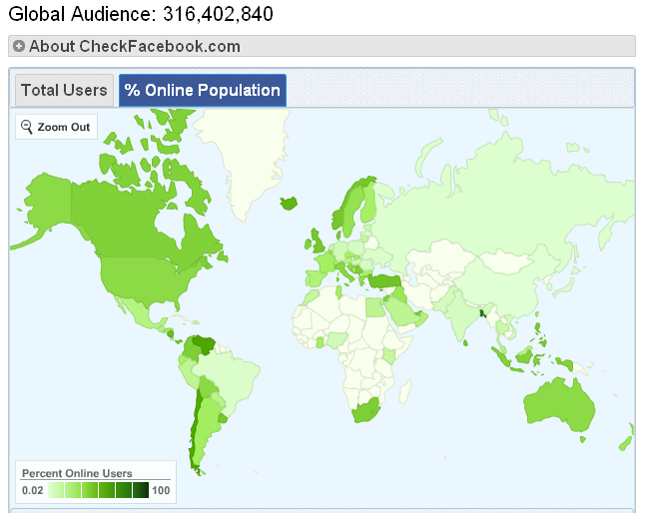
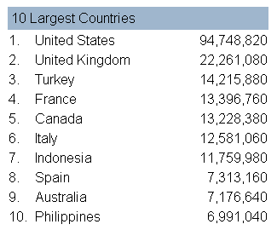
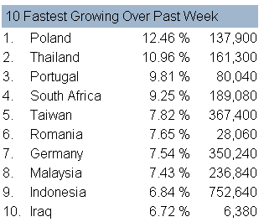
Facebook (Data as of beginning of Nov. 2009)

Slide 6
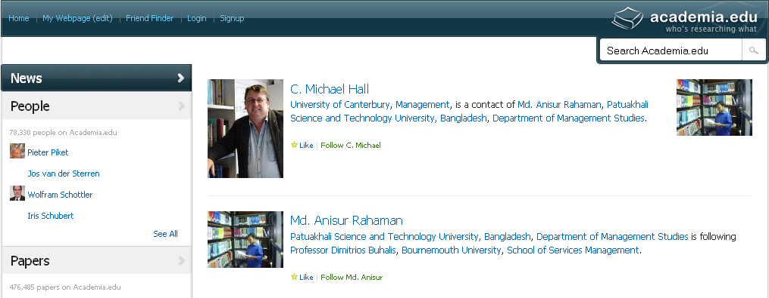
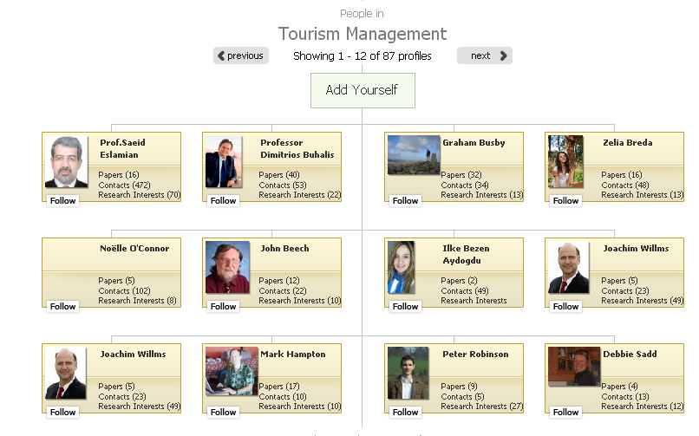
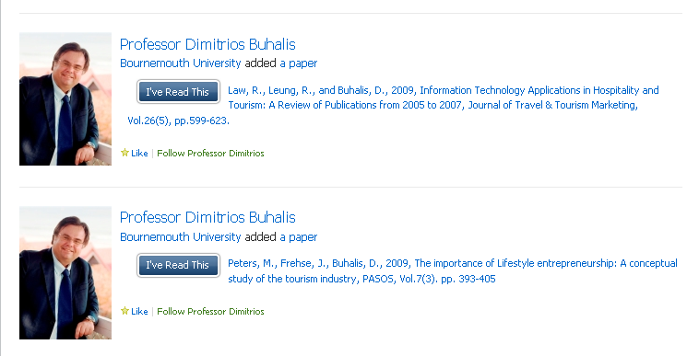
Academia.edu (Screenshot Nov. 22, 2009)
78.000 researchers,
476.000 paper online.

Slide 7
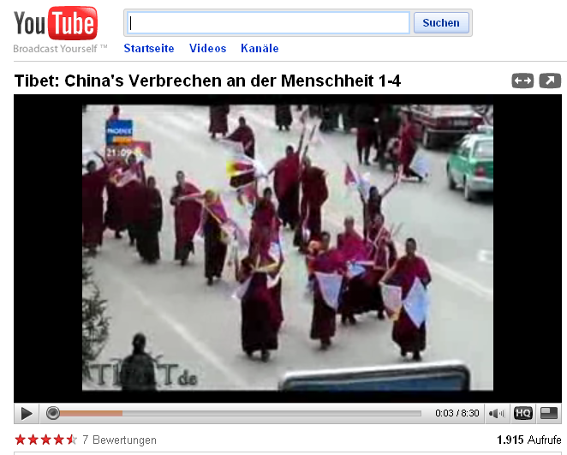
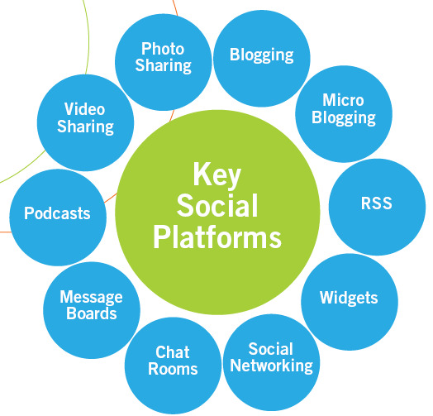
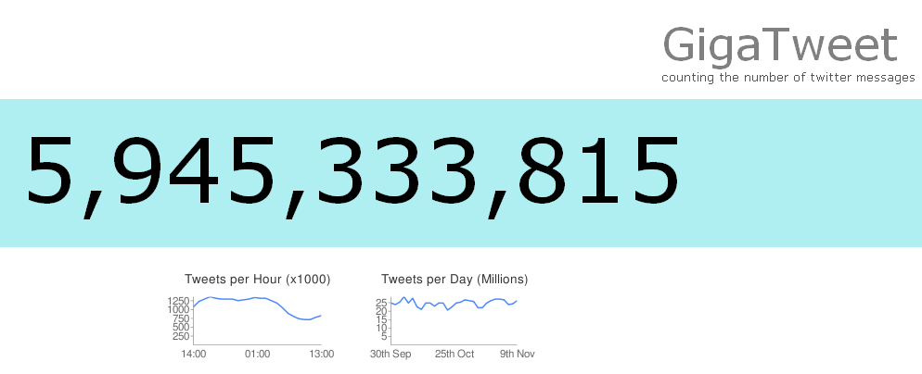
Social Media Forms

Slide 8
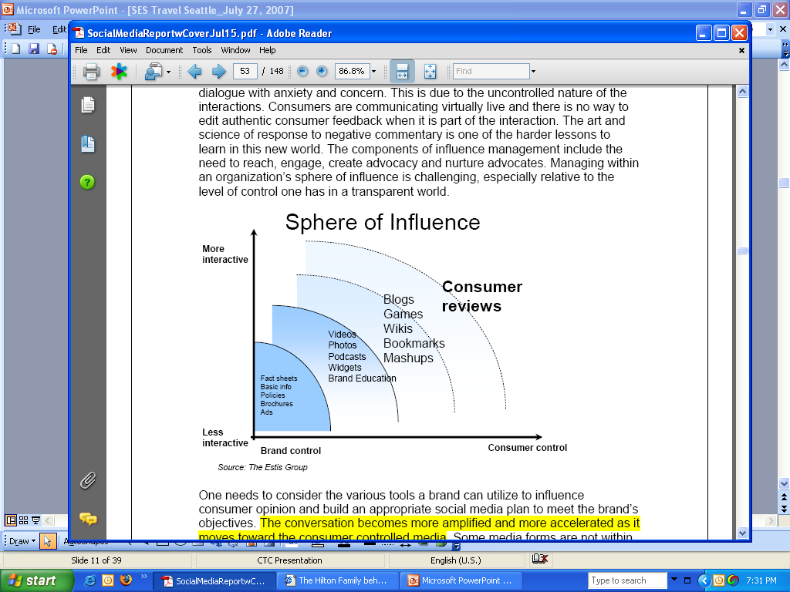
Social Media as Marketing Instrument
Social Media Marketing = Marketing which enables the consumer to further develop and tell the story of the brand by sharing his/her own thoughts, idea, opinions in the form of text, photos, videos etc. with other consumers.
Source: Chameleon Consulting

Slide 9
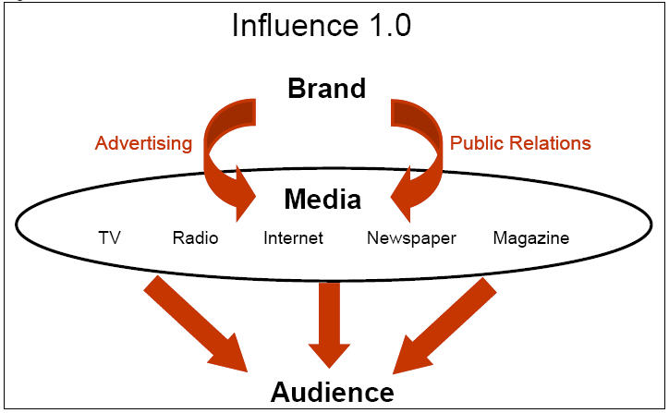
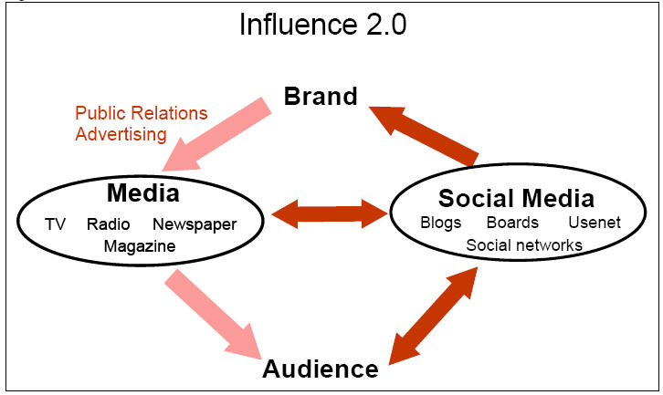
Social Media as Marketing Instrument
Quelle: Cymfony

Slide 10
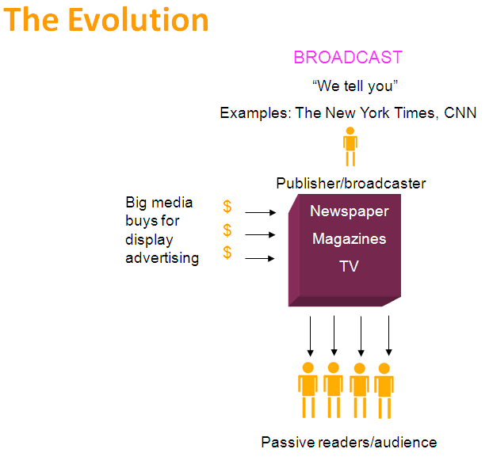
Evolution: From Broadcasting …

Slide 11
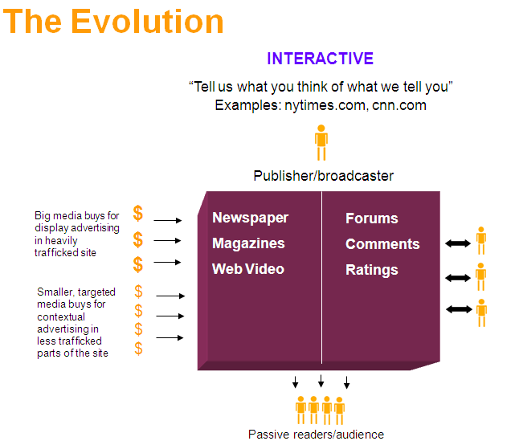
… to listening …

Slide 12
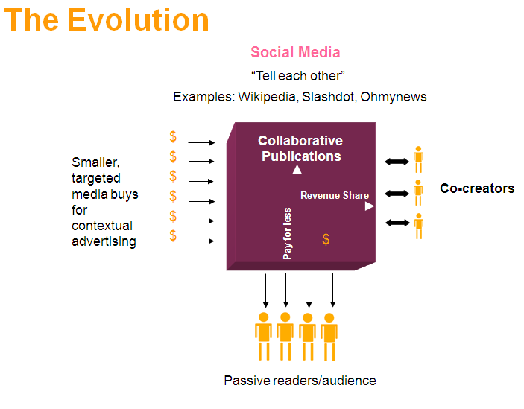
… towards dialogue
Source: Managementinnovationgroup

Slide 13

























Example Trip
Destination
Itinerary
Best Deal
Reserve & Pay
Experience & Communicate
Re-live, Inspire Others
Plan & Research
Shop & Compare
Travel
Share & Reminisce
Inspire
Book

Slide 14
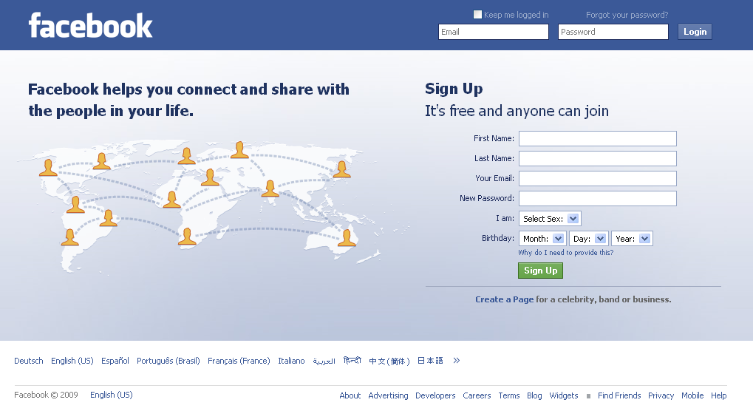
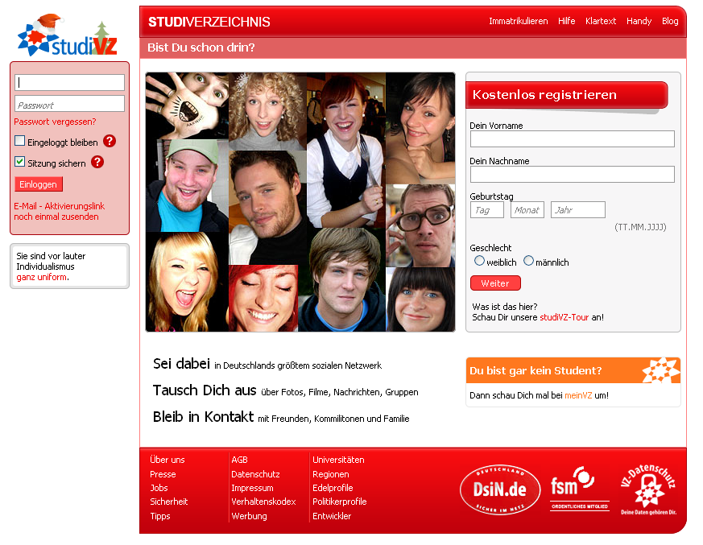
Internet 2.0 - Social Media Marketing across cultures - possible because user-driven?
All this is working well within one culture – how about negiotated cultures across borders (real, language, sub-group)?
Example: StudiVZ vs. Facebook

